Slide 1
Mitochondria part-1
Ram Balak Mahto
Guest faculty
Department of Zoology
V.S.J College Rajnagar Madhubani Class B.sc 2nd ,Paper 3 , 7908055676

Slide 2
Definition of Mitochondria
Mitochondria are oxygen-consuming ribbon-shaped cellular organelles of immense importance floating free throughout the cell.
They are known as the “powerhouse of the cell” since these organelles supply all the necessary biological energy to the cell by oxidizing the substrates available.
The enzymatic oxidation of chemical compounds in the mitochondria releases energy.
Since mitochondria act as the power-houses, they are abundantly found on those sites where energy is earnestly required such as sperm tail, muscle cell, liver cell (up to 1600 mitochondria), microvilli, oocyte (more than 300,000 mitochondria), etc.
Typically, there are about 2000 mitochondria per cell, representing around 25% of the cell volume.
In 1890, mitochondria were first described by Richard Altmann and he called them bioblasts. Benda in the year 1897 coined the term ‘mitochondrion’.

Slide 3
Structure of Mitochondria
Mitochondria are mobile, plastic organelles that have a double-membrane structure. It ranges from 0.5 to 1.0 micrometer in diameter. It has four distinct domains: the outer membrane, the inner membrane, the intermembrane space, and the matrix.
The organelle is enclosed by two membranes—a smooth outer membrane and a markedly folded or tubular inner mitochondrial membrane, which has a large surface and encloses the matrix space.
The intermembrane space is located between the inner and outer membranes.
The number and shape of the mitochondria, as well as the numbers of cristae they have, can differ widely from cell type to cell type.
Tissues with intensive oxidative metabolism— e. g., heart muscle—have mitochondria with particularly large numbers of cristae.
Even within one type of tissue, the shape of the mitochondria can vary depending on their functional status.
Both mitochondrial membranes are very rich in proteins.

Slide 4
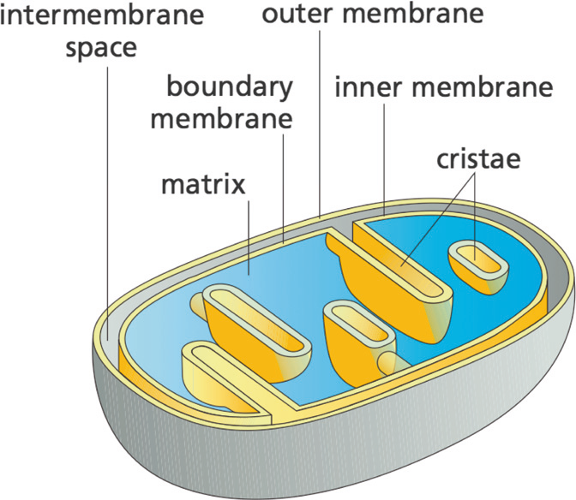
Membrane arrangement inside the mitochondria

Slide 5
Outer Mitochondrial Membrane
The outer mitochondrial membrane resembles more with the plasma membrane in structure and chemical composition.
Porins in the outer membrane allow small molecules to be exchanged between the cytoplasm and the intermembrane space.

Slide 6
Inner Mitochondrial Membrane
The inner mitochondrial membrane is rich in many enzymes, coenzymes, and other components of electron transport chain. It also contains proton pumps and many permease proteins for the transport of various molecules such as citrates, ADP, phosphate, and ATP.
The inner mitochondrial membrane gives out finger-like outgrowths (cristae) towards the lumen of the mitochondrion and contains tennis-racket shaped F1 particles that contain ATP-ase enzyme for ATP synthesis.
The inner mitochondrial membrane is completely impermeable even to small molecules (with the exception of O2, CO2, and H2O).
Numerous transporters in the inner membrane ensure the import and export of important metabolites.

Slide 7
Intermembrane Space
It is the space between the outer and inner membrane of the mitochondria, it has the same composition as that of the cell’s cytoplasm.
There is a difference in the protein content in the intermembrane space.

Slide 8
Thank you

